Slide 1
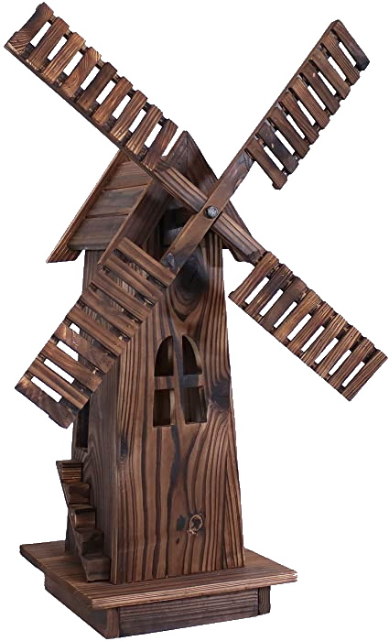
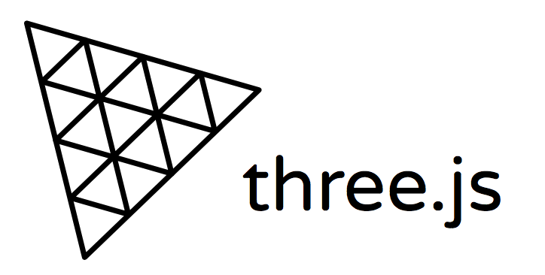
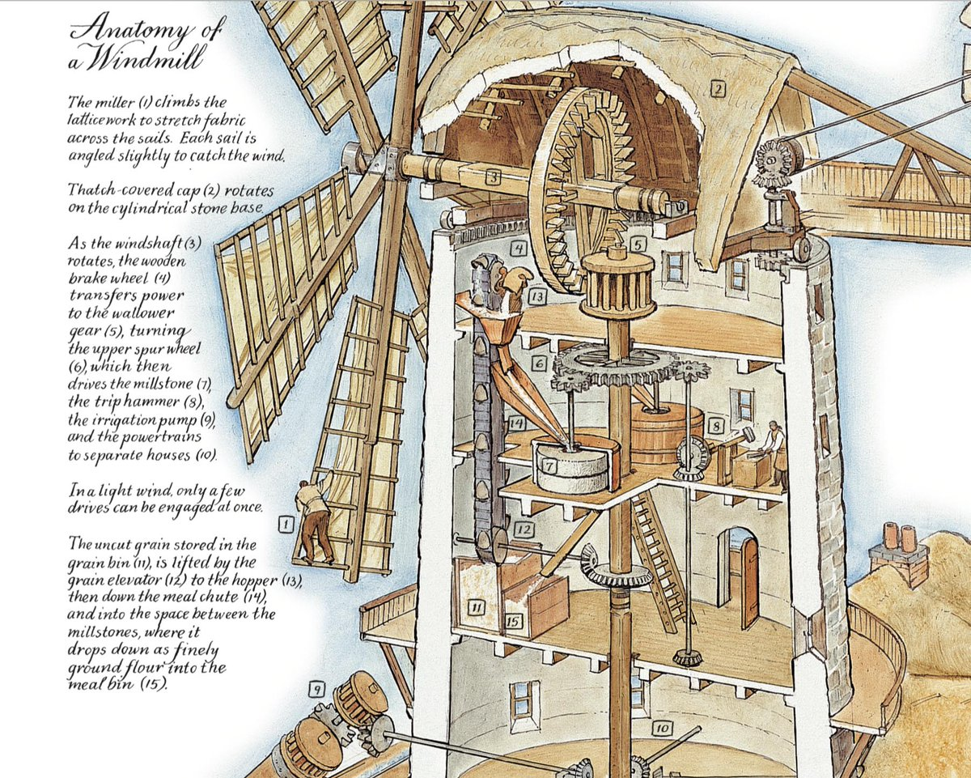
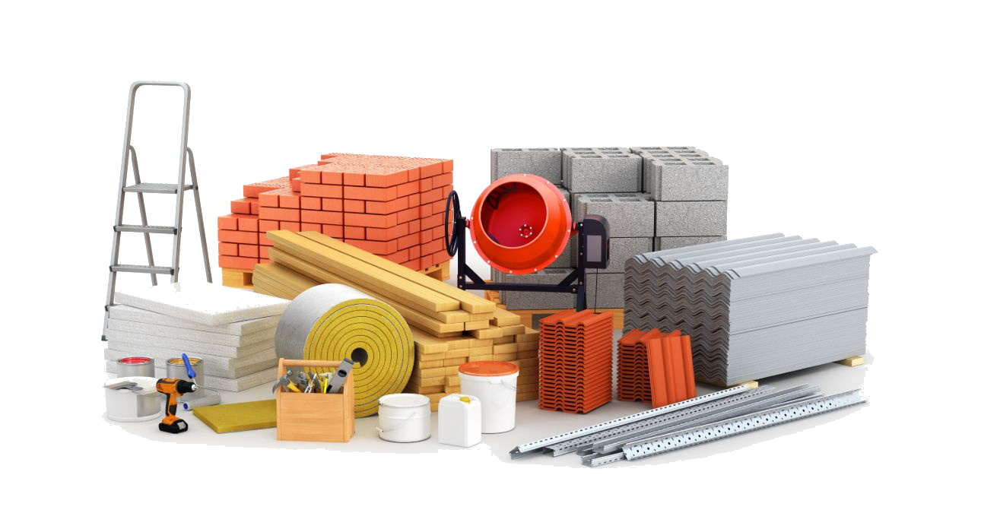
Windmill Design
Expected Textures
Wood, Stone brick base
Wooden windmill blades
Expected Language
HTML and Javascript
Includes Three.js
Working on
Inside of windmill
Landscape

